Slide 1
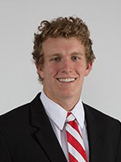
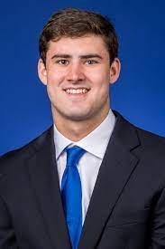
Ryan Finley vs Daniel Jones Draft Comparison
Brandon Wisniewski, Abhi Joshi, Pat Walther, Connor Stephens, & Robbie Goss
Notes:
Disclaimer: we did not include the six games ryan finley played at Boise State

Slide 2
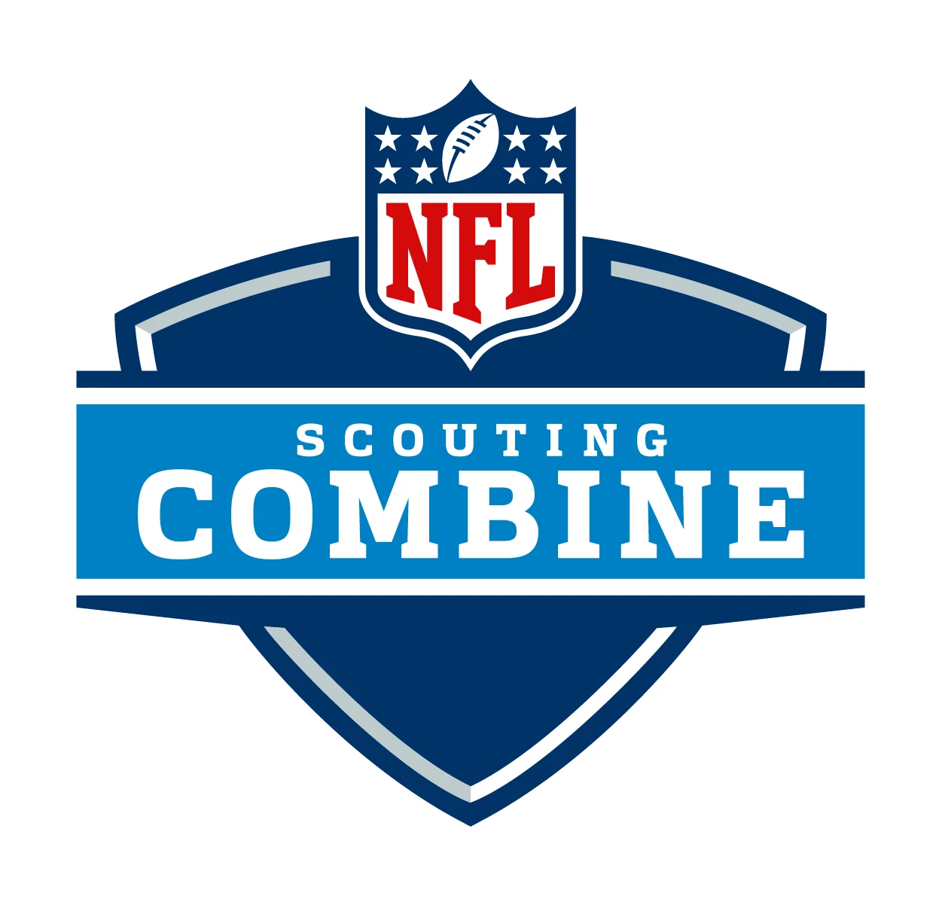
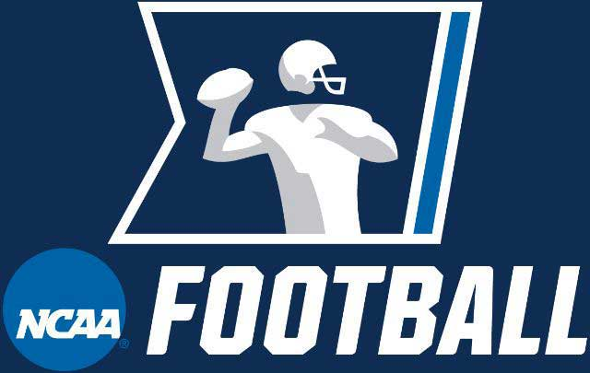
What are Indicators of Success in NFL for College QBs
Notes:
From a study conducted by J. Dean Craig from the University of Colorado at Colorado Springs and Niven Winchester of the Auckland University of Technology, they found that “college quarterbacks must be high-quality passers to make the NFL” and “quarterbacks who recorded higher college QBR values performed better in the NFL than players with lower QBR values” from conducting data analysis to find out the likeliness that a college quarterback will succeed in the NFL.
Article from bleacher report which anonymously interviewed NFL scouts had them cite IQ which the Wonderlic measures and has the ability to extend plays which can be observed in statistics such as SPARQ rating that are designed to measure athleticism which is crucial to extend plays

Slide 3
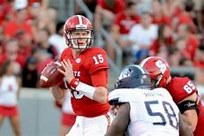
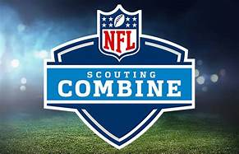
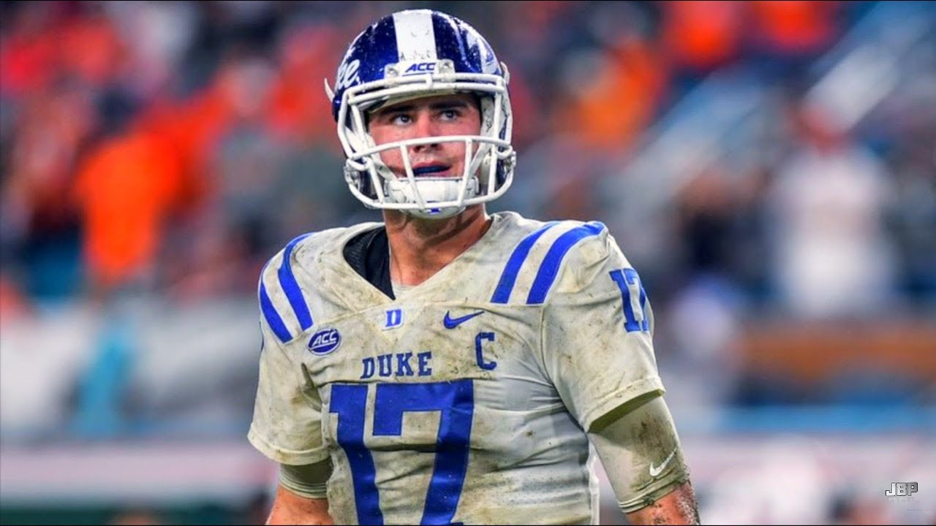
Combine Statistics
 | SPARQ (Athleticism) | SPARQ Percentile | Wonderlic (Intellect) | Wonderlic Percentile
Ryan Finley | 96.5 | 71st Percentile | 43 | 98th Percentile
Daniel Jones | 92.1 | 56th Percentile | 37 | 84th Percentile

Slide 4
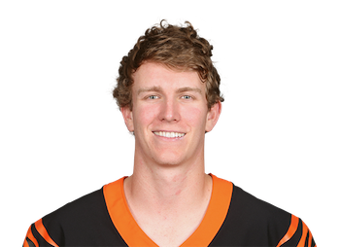
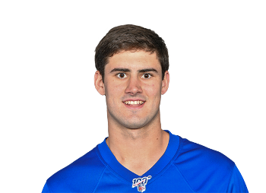
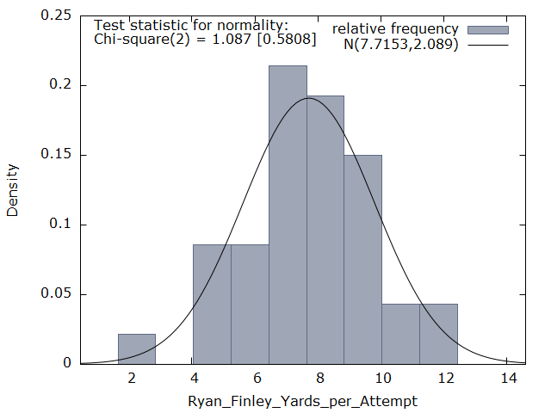
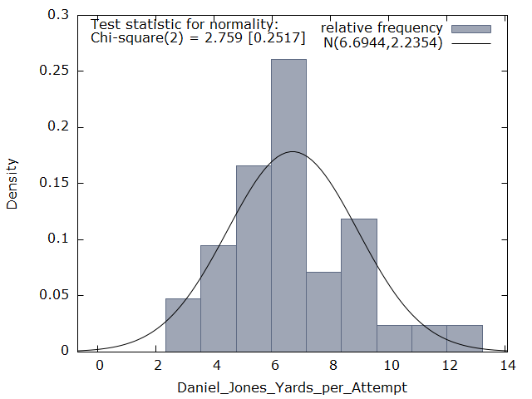
Yards Per Attempt (YPA)
Finley: 7.7 YPA (36th %tile) Jones: 6.8 YPA (9th %tile)

Slide 5
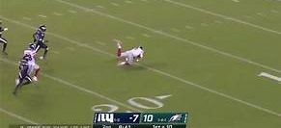
Quarterback Rating (QBR) and Passer Rating
NCAA Passer Rating
 | QBR | Percentile
Ryan Finley | 79.5 | 69th
Daniel Jones | 72 | 41st
 | 2016 | 2017 | 2018 | Total
Ryan Finley | 135.2 | 136 | 148 | 138.4
Daniel Jones | 126.3 | 112 | 131.7 | 122.9

Slide 6
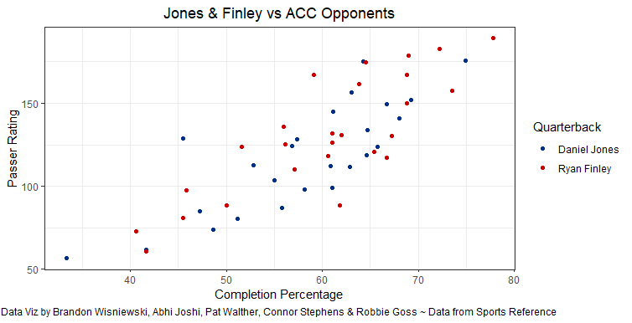
Success vs ACC Competition

Slide 7
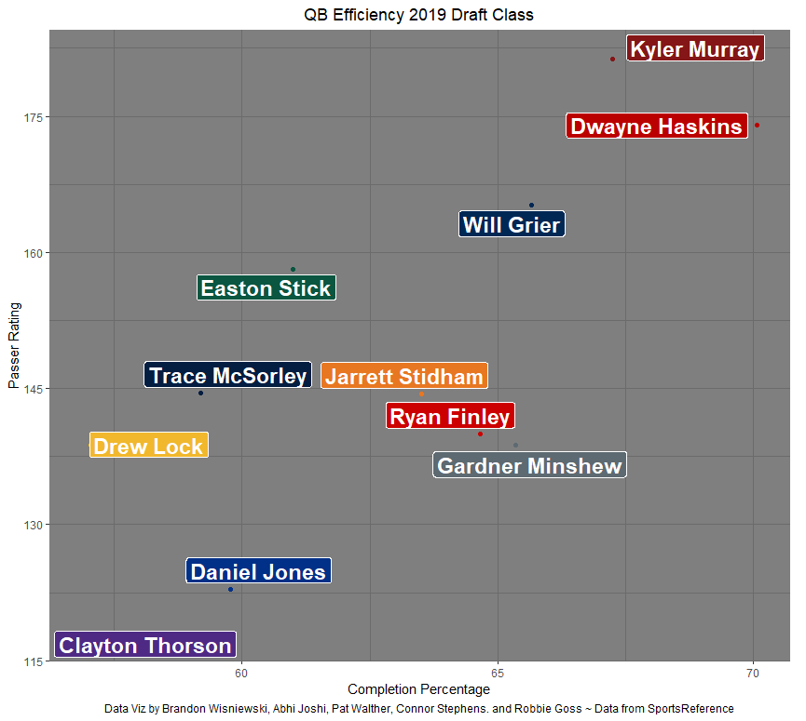
Comparison to the Rest of their Draft Class
 | Ryan Finley | Daniel Jones
Wonderlic | 1st/11 | 3rd/11
SPARQ Score | 4th/8 | 6th/8
QBR | 5th/10 | 9th/10
YPA | 7th/11 | 10th/11

Slide 8
Sources:
Hermsmeyer, Josh. “The NFL Is Drafting Quarterbacks All Wrong.” FiveThirtyEight, FiveThirtyEight, 27 Feb. 2019, https://fivethirtyeight.com/features/the-nfl-is-drafting-quarterbacks-all-wrong/.
Craig, J. Dean, and Niven Winchester. “Predicting the National Football League Potential of College Quarterbacks.” European Journal of Operational Research, Mar. 2021, 10.1016/j.ejor.2021.03.013. Accessed 25 Apr. 202
Miller, Matt. “The Art of Scouting Quarterbacks: How Scouts Win and Whiff in Today’s NFL.” Bleacher Report, bleacherreport.com/articles/2681374-the-art-of-scouting-quarterbacks-how-scouts-win-and-whiff-in-todays-nfl. Accessed 29 Nov. 2021
“College Football Statistics and History: College Football at Sports.” Reference.com, https://www.sports-reference.com/cfb/.
.

